Slide 1
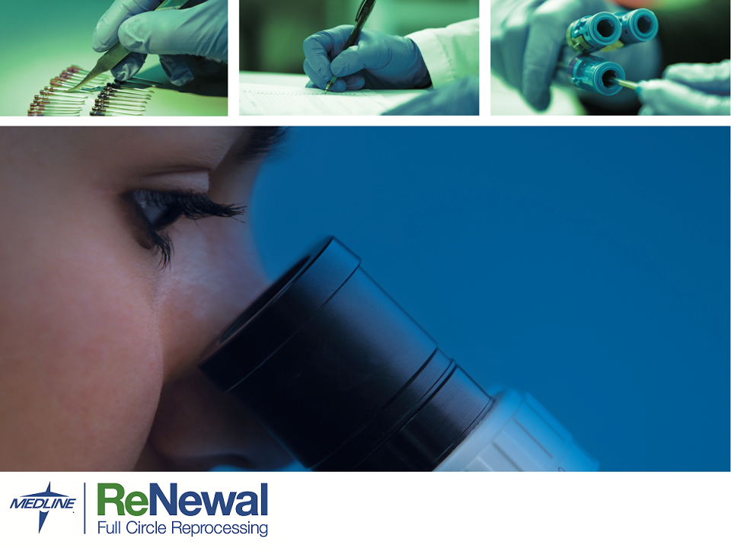
MECOP Presentation
Jessica dela Cruz
Mechanical Engineering
2nd Internship
October 2, 2017
Contacts & Facility Logo

Slide 2
History
Jessica dela Cruz | Mechanical Engineering | 2nd Internship
Founded in 1997 under the name Surgical Instruments Servicing & Solutions (SISS) in Sisters, OR
Rebranded as Medisiss and moved to Redmond, OR in 2003
In 2012, the company was purchased by Medline Industries
Rebranded as Medline ReNewal in 2013
Still in Redmond, Medline moved from 6 separate buildings to one consolidated building they had built
Medline is debt free!

Slide 3
Reporting structure
Jessica dela Cruz | Mechanical Engineering | 2nd Internship
Frank Czajka
Division President
Steve Bettis
VP of Operations
Eric Nyquist
Director of Engineering, MECOP Representative
Loren Eby
Product Development (PD) Lab Manager, Mentor
Jessica dela Cruz
PD MECOP Intern

Slide 4
Work information
Jessica dela Cruz | Mechanical Engineering | 2nd Internship
Benefits
Schedule
$20/hr
Paid holidays
Two float holidays available
1 hour of sick leave for every 30 hours of work
All benefits regular hires receive
Able to choose start date
40 hrs/wk
8:00 am – 4:30 pm, MTWRF
Flexible hours if needed
30 minutes to 1 hour lunch
Notes:
Catch: Can’t miss the day before or after holiday

Slide 5
My department and department interaction
Jessica dela Cruz | Mechanical Engineering | 2nd Internship
Worked in the product development (PD) department
Designed fixtures and tooling for other engineers’ projects
Championed an equipment redesign
Helped maintain existing equipment
Interacted with a few other departments
Manufacturing engineering
Decontamination
Refurbishing
Primary Wash

Slide 6
List of Projects
Jessica dela Cruz | Mechanical Engineering | 2nd Internship
Support IQ/OQ on Equipment
CLiDe System revisions
MakerBot troubleshooting
Sink-pipe splash guard
Open jaw fixture design
3D print test display board
Motic camera calibration
Geddis redesign
Suction chamber redesign
Crest basket design
Ultrasonic study
Comparitive pump flow study
Medical device model
Tissue pad design
Beam-O counter
Mezzanine lift
MakerBot filament stand
Black box fixture redesign
Time temperature plate redesign
Decon department line numbering

Slide 7
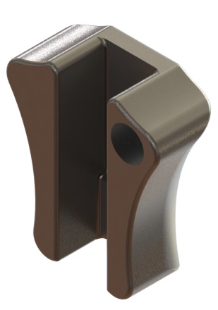
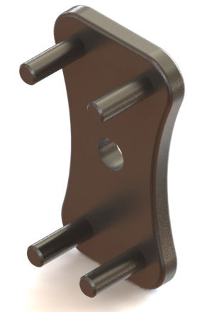
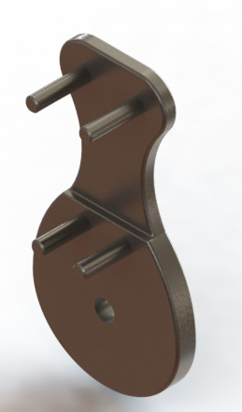
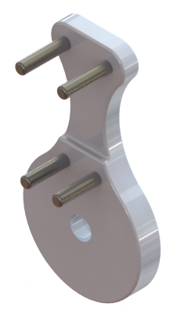
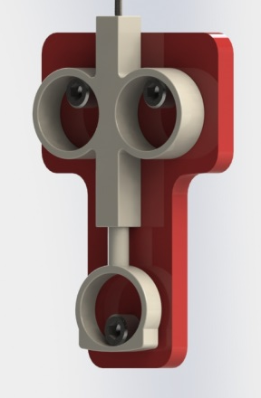
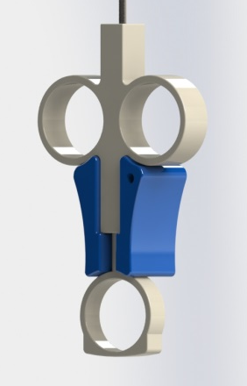
Open jaw fixture
Design a fixture that will keep a device’s jaw open
Went through multiple iterations
3D printed the different iterations
Got finalized fixture machined with David at Mountain EDM
Main takeaway: Design something with your customer and machinist in mind

Slide 8
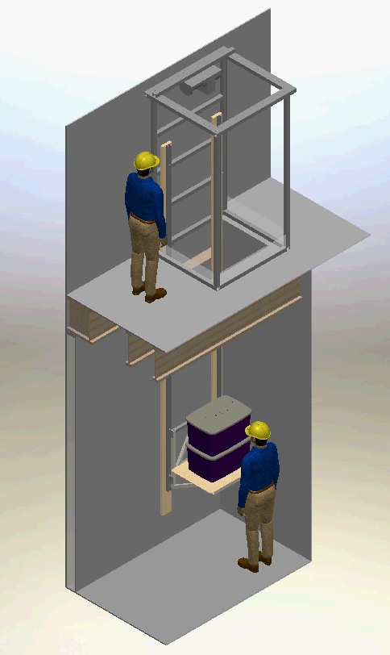
Mezzanine Lift
Problem
Moving bins into the mezzanine required excessive movement and man power.
Objectives
Develop a materials lift that can bring up multiple bins (~50 lbs. each) at a time.
Results
Designing and developing our own lift wasn’t cost effective and required building permits.
Found an off the shelf option, a Versalift, that suits our needs, is cost effective, and doesn’t require building permits.

Slide 9
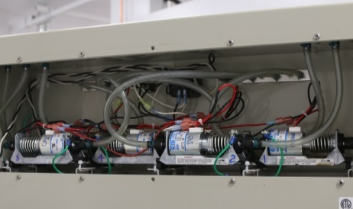
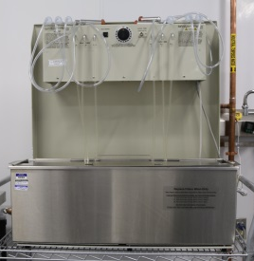
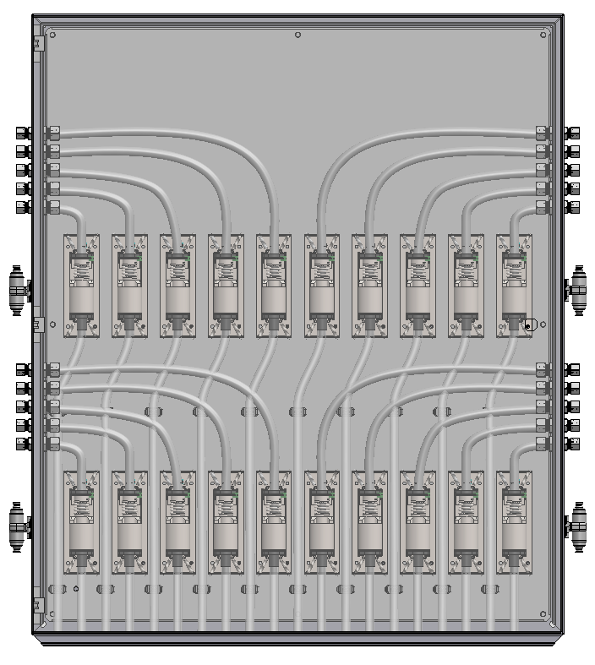
Geddis Redesign
Problems
The current Geddis machines weren’t keeping up with production.
The design of the Geddis makes maintenance difficult.
Objectives
Design an enclosure to accommodate 12-18 pumps to be used with a 20 gal. Crest.
Design for easy maintenance.

Slide 10
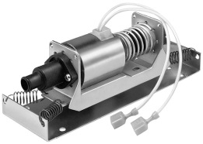
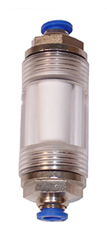
Added components to the project
Spec’ing out a new pump
Find a new pump that works with the chemicals being used and has increased flow
Spec’ing out a new filter
Find a comparable filter that is easier to change out
Ultrasonic study
The Crest ultrasonic needed to be validated to be used with the Geddis
Average Flow (GPM)
Head Height | Current Pump | New Pump
63 w/ Filter | 0.307 | 0.456
24 w/ Filter | 0.407 | 0.642

Slide 11
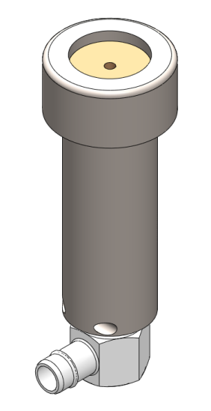
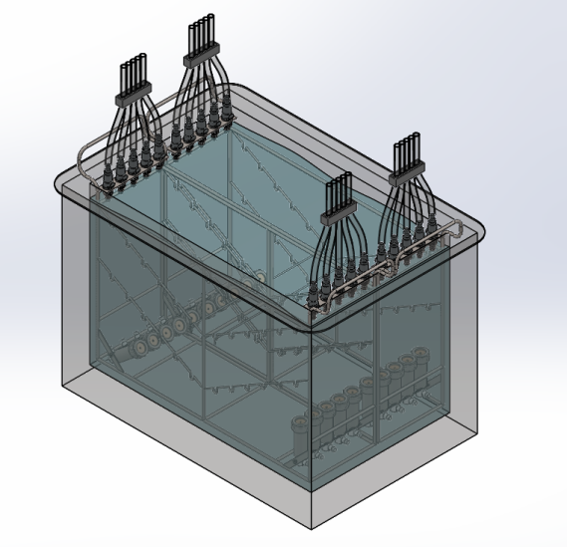
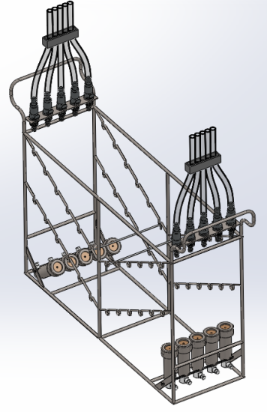
Added components to the project
Suction chamber redesign
Design a suction chamber that is cheaper to purchase and maintain than the current one
Basket design
Designed a basket to easily load devices into the Crest

Slide 12
How I Benefited from Medline/ Takeaways
Feel more confident in my skills and in finding a job after graduating
The importance of instant communication (i.e. phone calls)
Toured machine shops
More conscious about machinists/ machining capabilities when designing fixtures and tools
Learned about 3D printing and troubleshooting the printer
You can design all you want on SolidWorks, but you’ll only know if the design works when you build it

Slide 13
Useful courses
Jessica dela Cruz | Mechanical Engineering | 2nd Internship
MECH475 – Parametric Modeling (SolidWorks)
MEG314 – Geometric Dimensioning and Tolerancing
SPE111 – Public Speaking
SPE321 – Small Group/ Team Communication
WRI327 – Advanced Technical Writing

Slide 14

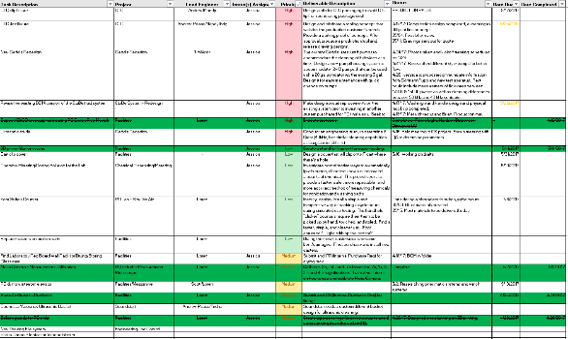
Internship comparisons
Jessica dela Cruz | Mechanical Engineering | 2nd Internship
Consolidated Metco
Medline Renewal
Heavy duty trucking transportation components
Vancouver, WA
Projects given as I completed them
More hands on projects and project managing
Separate buildings for some departments
Higher wage, but no sick time or vacation time
Reprocessing medical devices
Redmond, OR
List of projects from the start
More design work
Projects involved a lot of collaborating
Everyone is under one roof
Lower wage than ConMet, but more benefits

Slide 15
QUESTIONS?
Jessica dela Cruz | Mechanical Engineering | 2nd Internship
Thank you!

